Slide 1

Breast Cancer Prediction
In this presentation, we will explore how AI and machine learning techniques can be leveraged to predict breast cancer with high accuracy. We will cover the key steps involved , preprocessing techniques , trained models and highlighting the insights and findings that emerged from our analysis.
- Atharv Sasturkar

Slide 2
Data Preprocessing Techniques
Resizing
Normalization
Data Augmentation
To ensure all images have a uniform size, which is a requirement for most models.
To scale pixel values to a specific range.
Methods:
Divide pixel values by 255 (if pixel range is 0-255).
Apply mean subtraction and standard deviation scaling
To artificially increase dataset size and diversity, reducing overfitting..
Grayscale Conversion
Histogram Equalization
For tasks where color is irrelevant, converting to grayscale reduces data complexity
To enhance contrast, especially in poorly illuminated images.

Slide 3

Feature Extraction methods
1
GLCM (Gray-Level Co-occurrence Matrix)
GLCM analyzes the spatial relationship between pixel intensities in an image
2
LBP (Local Binary Patterns)
Extracts local texture features by comparing each pixel with its surrounding neighbors.
3
MVM-LBP (Multi-View Multi-scale Local Binary Patterns)
Employed techniques like oversampling and undersampling to address the class imbalance in the dataset.

Slide 4





Model Evaluation
Accuracy
1
The overall correctness of the model's predictions.
2
Precision
The ability to correctly identify positive instances.
3
Recall
The ability to correctly identify all positive instances.
4
F1-Score
The harmonic mean of precision and recall, providing a balanced metric.
ROC-AUC
5
The area under the Receiver Operating Characteristic curve, measuring the model's discrimination ability.

Slide 5

Comparative Analysis of Models
78%
73%
VGG-16
Resnet50
Demonstrated the highest accuracy of 78% among the models tested.
Achieved an accuracy of 73% in predicting breast cancer risk.
76%
Resnet18
Delivered an impressive 76% accuracy, with fast training and efficient performance.

Slide 6

Key Findings and Insights
1
Superior Model Performance
2
Potential Clinical Impact
VGG-16 emerged as the top-performing model, achieving an impressive 78% accuracy in breast cancer prediction.
The high-accuracy models developed in this study can aid early detection and interventions, leading to improved patient outcomes.

Slide 7
Future Directions and Conclusion
Explore Ensemble Techniques
1
Investigate the potential of combining multiple models to further enhance the prediction accuracy.
Incorporate External Data
2
Incorporate additional data sources, such as genomic or medical imaging data, to enrich the feature set and improve model performance.
Develop Clinical Decision Support
3
Integrate the AI-powered breast cancer prediction models into clinical decision support systems to aid healthcare professionals.

Slide 8


Slide 9
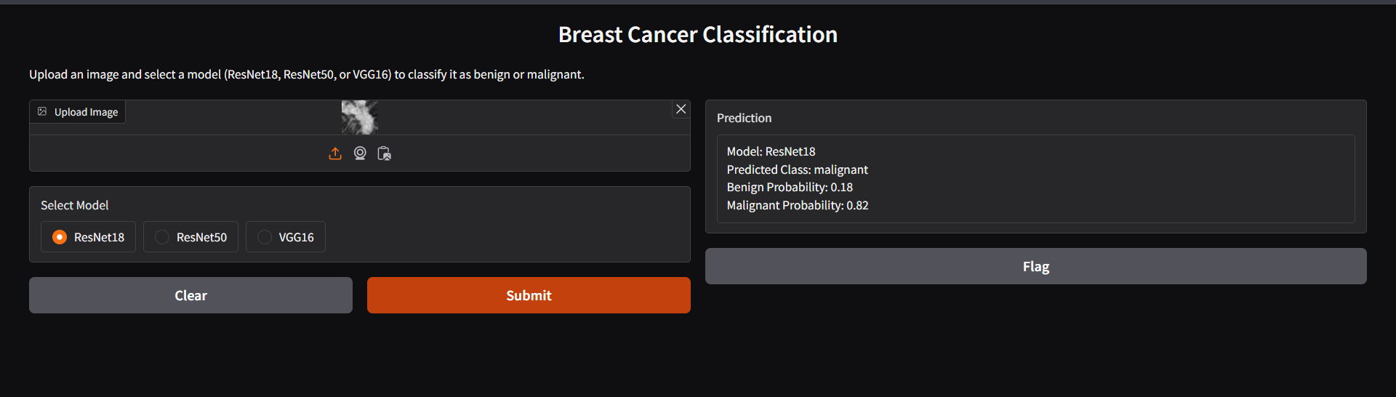
THANK YOU

